Slide 1

Programming for Everybody (Starting with Python)

Slide 2

Overview
The author of the course is Dr. Charles “Chuck” Russell Severance, an American computer scientist, Clinical Associate Professor of Information at the University of Michigan.
He is also the first Chief Architect of the Sakai Project

Slide 3
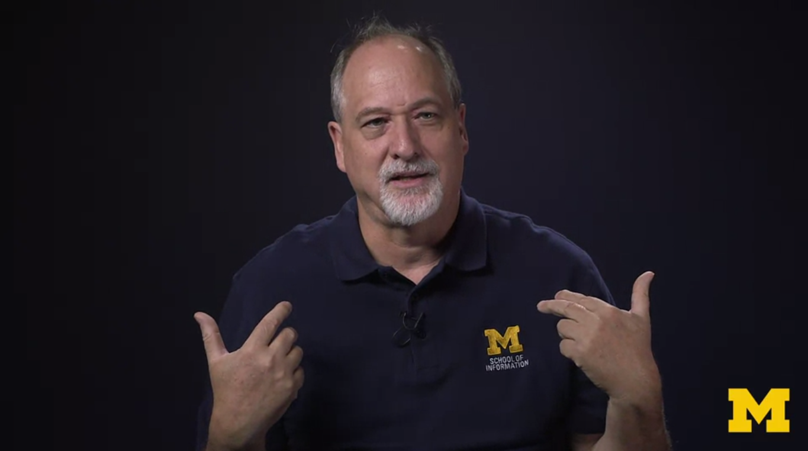

Slide 4

Week 1: Why do we Program?
Introduction
“Your job is to serve the user”
Hardware overview
«Central processing unit, main memory, secondary memory unit and input/output devices»
Python as a language
«Python was not named for a snake»

Slide 5
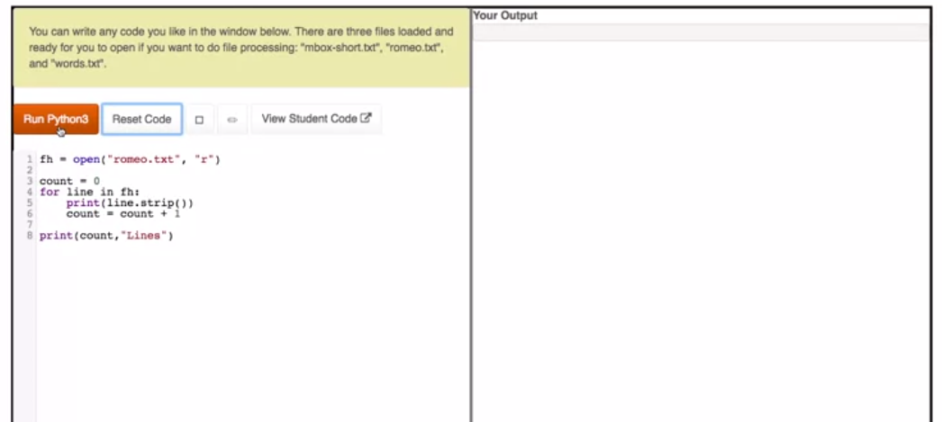
Week 2: Installing and Using Python
Introduction to course playground
Installing Python and Atom
Optional Assignment

Slide 6
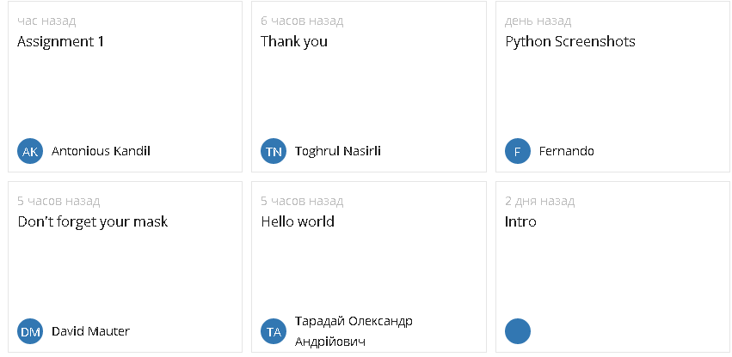

Slide 7
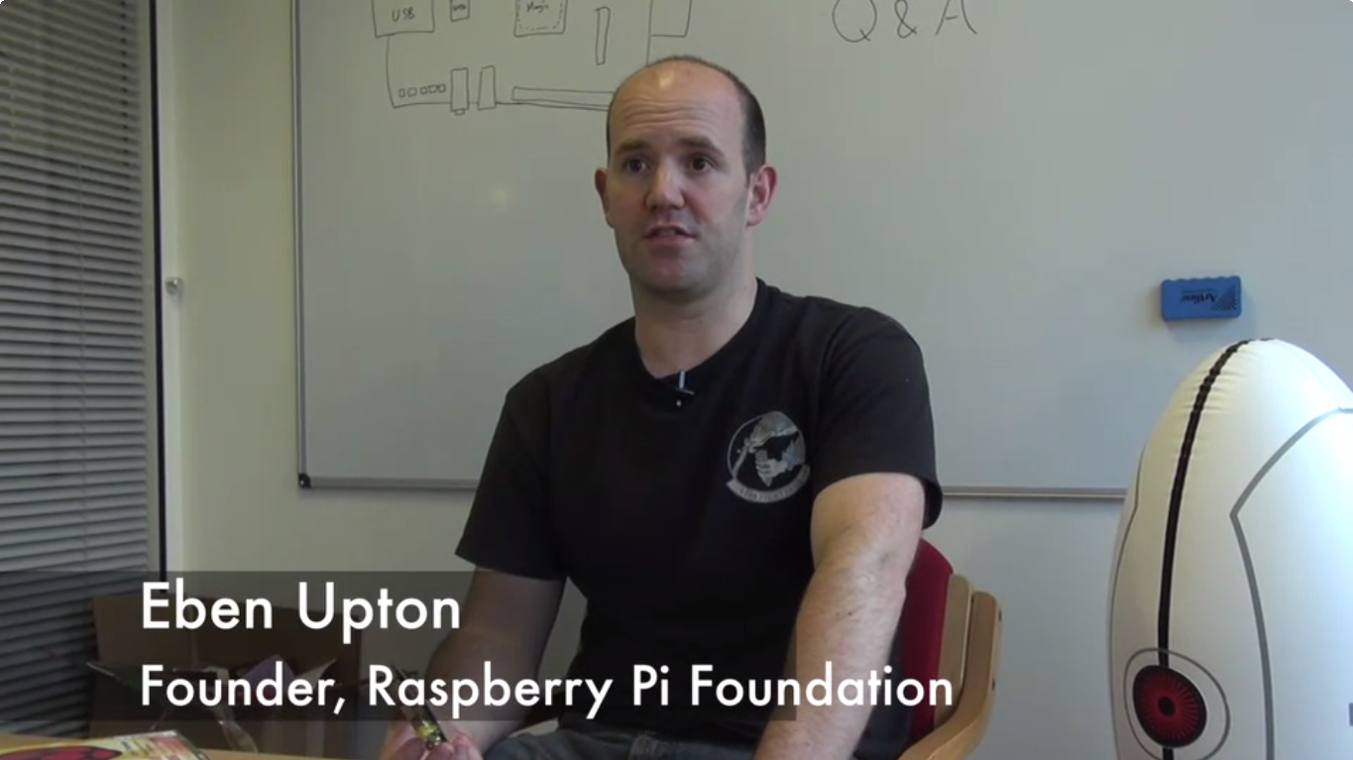

Slide 8
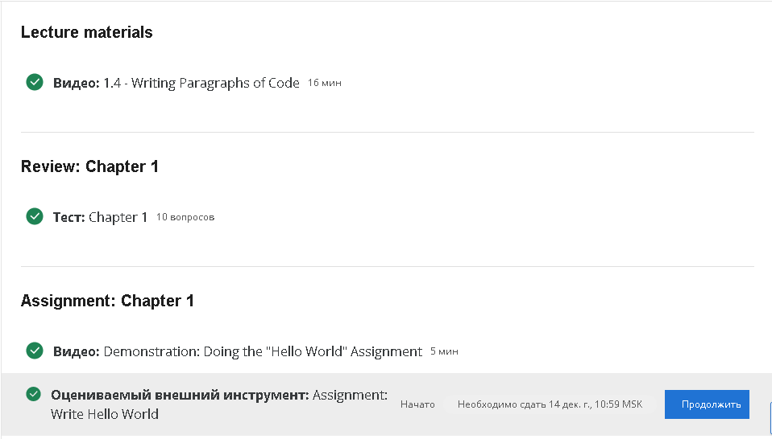
Week 3: Hello World (really?)

Slide 9
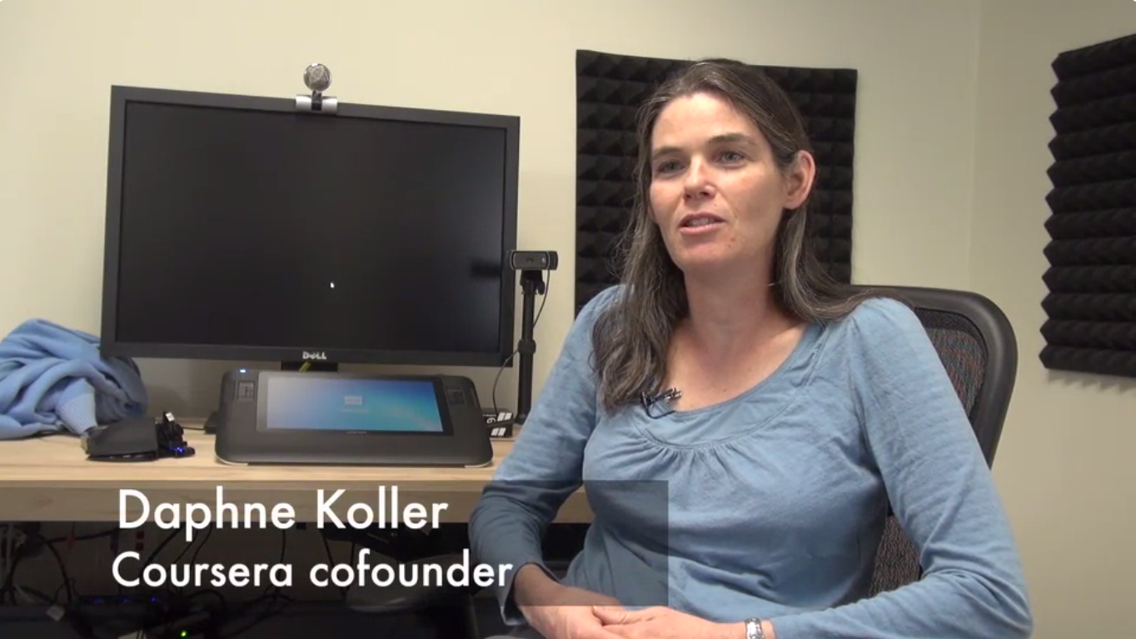

Slide 10
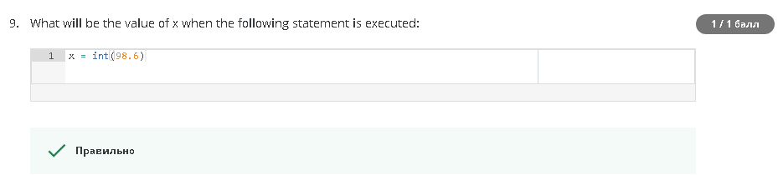
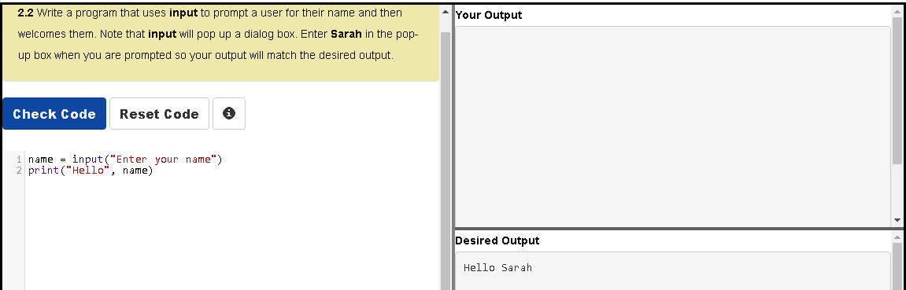
Week 4: Variables and Expressions

Slide 11
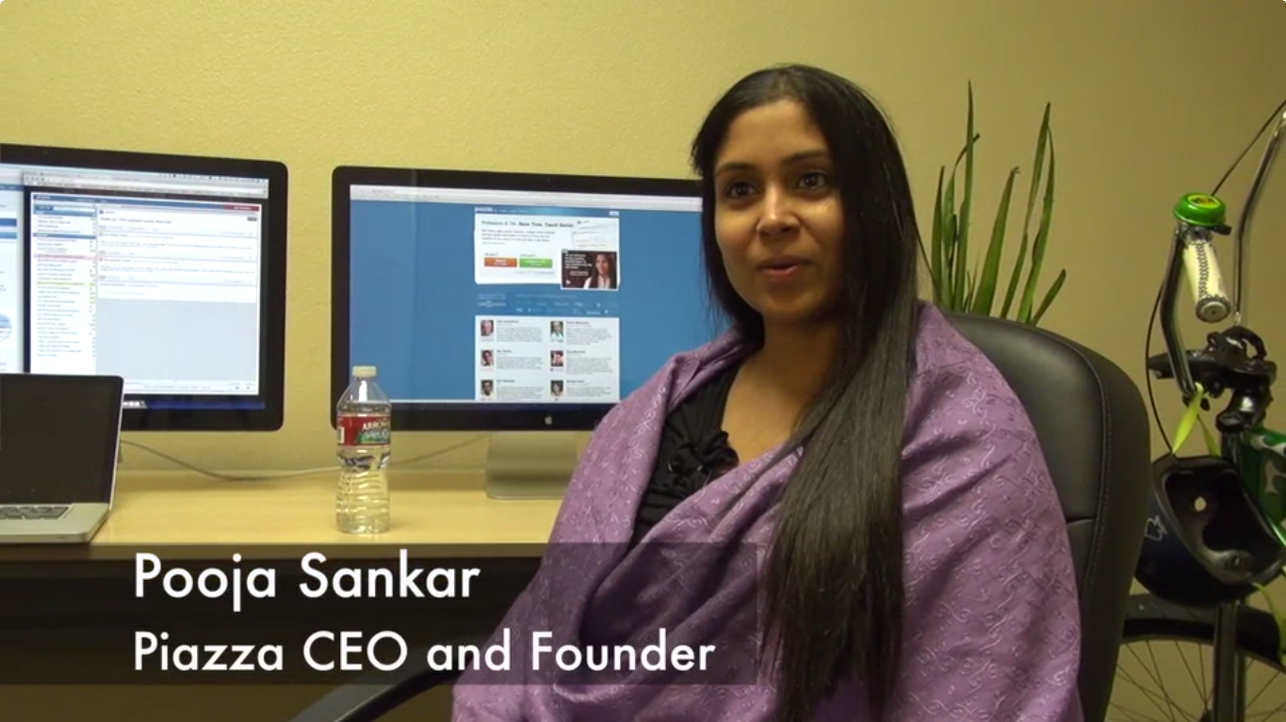

Slide 12
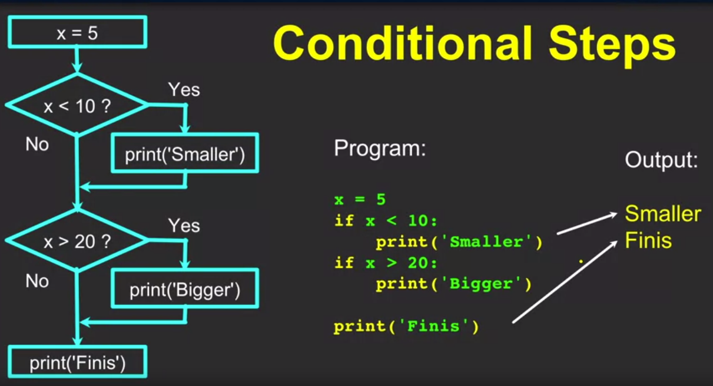
Week 5: Conditional Statements

Slide 13
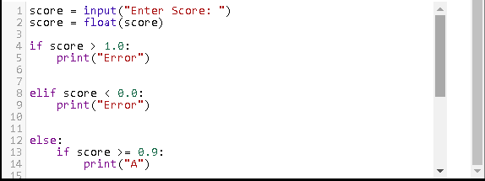
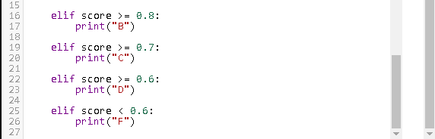

Slide 14
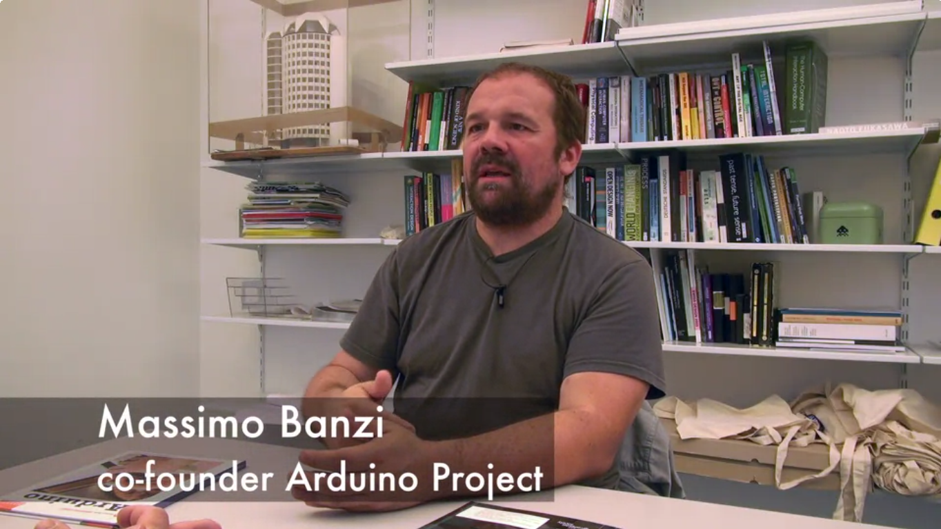

Slide 15
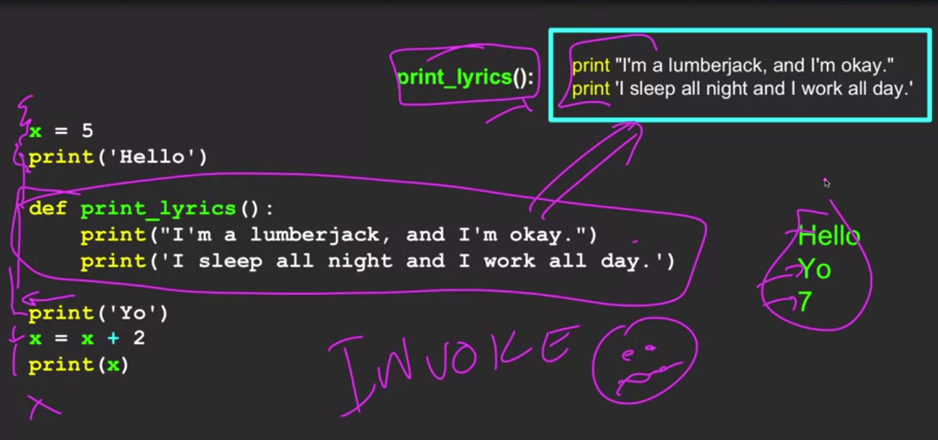
Week 6: Functions
«As the book moves into more and more complex programs, functions will be an essential way for us to make sense of our code.»

Slide 16
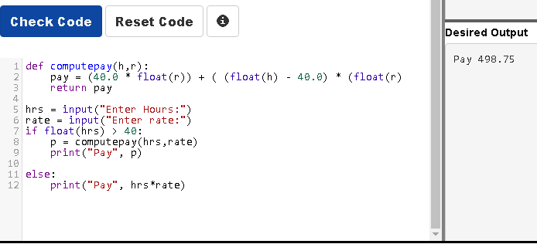

Slide 17
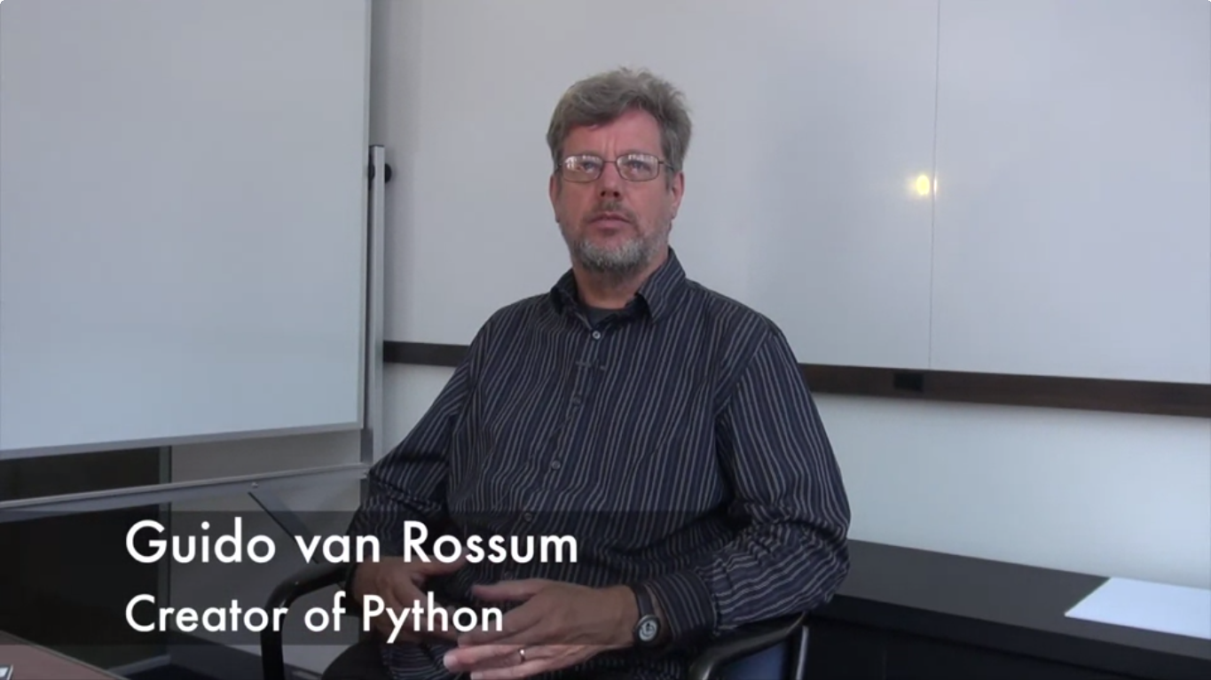

Slide 18
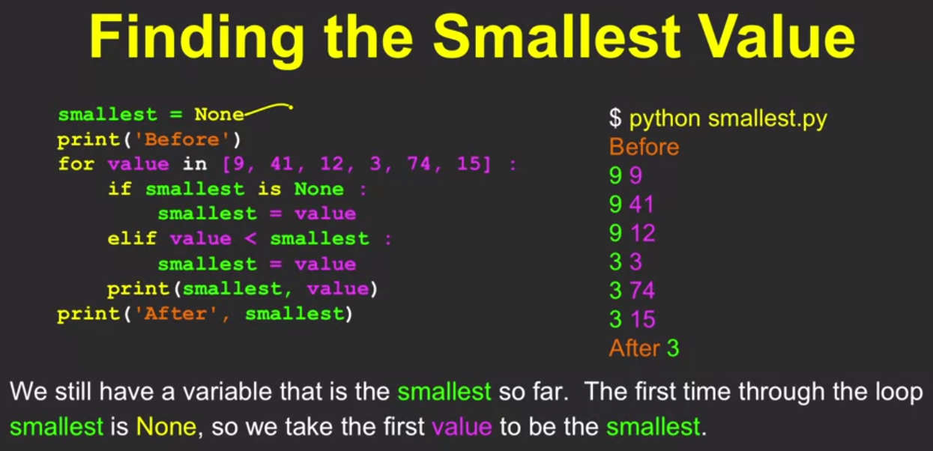
Week 7: Loops and Iterations
«Loops are the way we build programs that stay with a problem until the problem is solved»

Slide 19
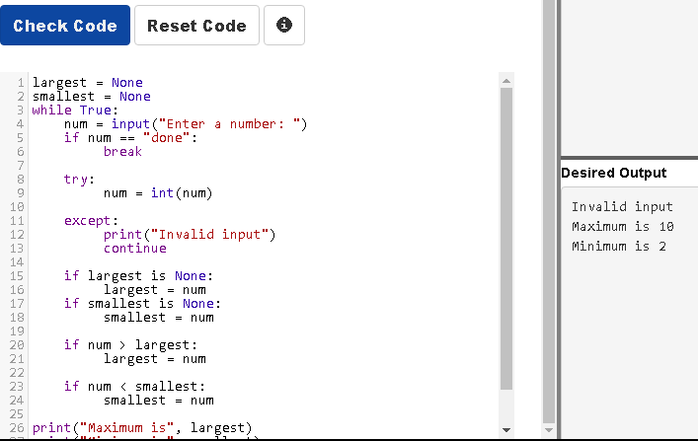

Slide 20

What’s next?
Data structures of Python
Using Python to Access Web Data
Using Databases with Python
Retrieving, Processing, and Visualizing Data with Python

